Slide 1

Covid-19 Analysis
Balaji Avvaru

Slide 2
Data Set
Response Variable
Exogenous Variables
Response Variable: New positive cases in Washington state and USA
Daily observations from 02/29/2020 to 07/14/2020 for Washington state with 137 observations
Daily observations from 01/22/2020 to 07/14/2020 for US with 175 observations
An additional 4 exogenous variables were also collected.
Contained cumulative positive cases, cumulative negative cases, cumulative deaths
Positive percentage measure created
Data was collected from the COVID tracking project https://covidtracking.com/data/download

Slide 3
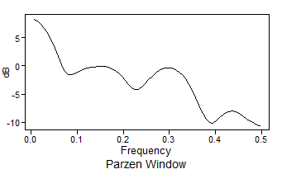
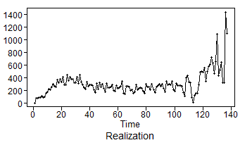
EDA: Checking Stationarity
Condition 1: Mean does not depend on time
The spectral density shows a high peak at 0, which could be generated by a stationary or non-stationary process.
Since the mean appears to change over time, this suggests a non-stationary process.
There appears to be a upward trend in the realization.

Slide 4
EDA: Checking Stationarity
Condition 2: Variance does not depend on time
Since only one realization is possible, it is difficult to assess the realization variance.
However, there is more volatility in the second half (after 110) than in the first half.
This may be an indication of non-constant variance, which would suggest a non-stationary process, but again difficult to say with just one realization.

Slide 5
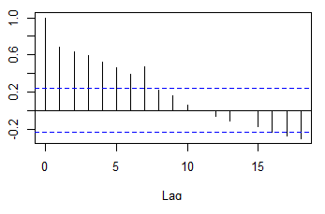
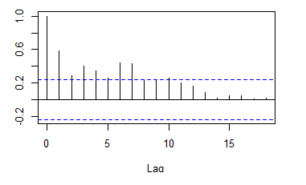
EDA: Checking Stationarity
First half
Condition 3: The correlation of $X_{t_{1}}$ and $X_{t_{2}}$ depends only on $t_{2}−t_{1}$
Condition 3: The correlation of 𝑿_(𝒕_𝟏 ) and 𝑿_(𝒕_𝟐 ) depends only on 𝒕_𝟐−𝒕_𝟏
The ACFs of the first half and second half exhibit different characteristics.
More exponentially damped autocorrelations and no hints of seasonality in the first half of the data.
This may suggest a non-stationary process, though the evidence is weak.
A hint of seasonality in second half of the data though it is not appreciable
second half

Slide 6
EDA: Checking Stationarity
Conclusion
We will continue the analysis modeling the data using both an ARMA (stationary) model and an ARIMA (non-stationary) model.
Based on the analysis, there appears to be some evidence that the process is non-stationary.

Slide 7
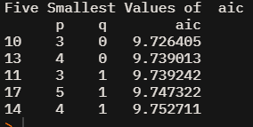
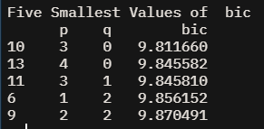
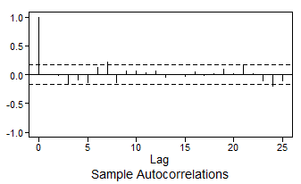
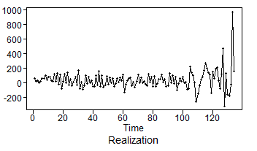
WA State - AR Model ID
AIC and BIC both indicate that an AR(3) might be an appropriate model.
Visual evidence from ACF plot that the residuals with AR(3) model are white
Ljung-box test with K=48 (p-value 0.23) fail to reject null hypothesis which suggests the residuals are white

Slide 8
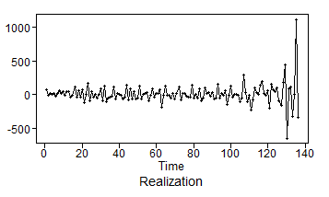
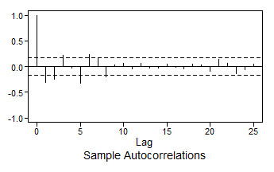
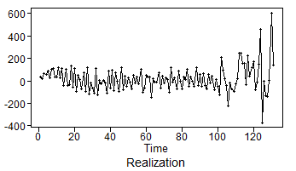
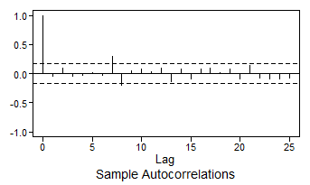
WA State - ARIMA Model ID
The overfit tables show that 1-B may be a dominant factor in the model. We will proceed with including only a (1-B) term (i.e. d = 1).
The differenced data seems stationary, but the residual doesn’t seem to be white
AIC and BIC both confirm that an AR(6) model is appropriate for the differenced data.
Ljung-box test with K=24 (p-value : 0.11) and K=48 (p-value 0.69) fail to reject null hypothesis which suggests the residuals are white

Slide 9
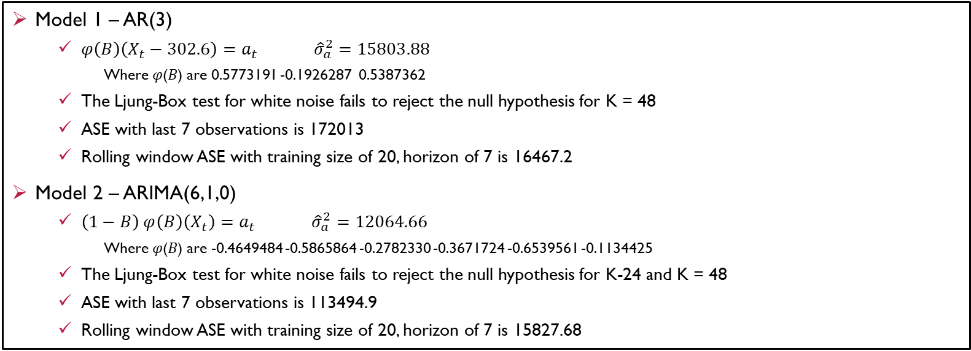
WA State – Model Comparison
Model 1 – AR(3)
$φ\left(B\right)\left(X_{t}−302.6\right)=a_{t} {\hat{σ}}_{a}^{2}=15803.88$
Where 𝜑(𝐵) are 0.5773191 -0.1926287 0.5387362
The Ljung-Box test for white noise fails to reject the null hypothesis for K = 48
ASE with last 7 observations is 172013
Rolling window ASE with training size of 20, horizon of 7 is 16467.2
Model 2 – ARIMA(6,1,0)
$\left(1−B\right) φ\left(B\right)\left(X_{t}\right)=a_{t} {\hat{σ}}_{a}^{2}=12064.66$
Where 𝜑(𝐵) are -0.4649484 -0.5865864 -0.2782330 -0.3671724 -0.6539561 -0.1134425
The Ljung-Box test for white noise fails to reject the null hypothesis for K-24 and K = 48
ASE with last 7 observations is 113494.9
Rolling window ASE with training size of 20, horizon of 7 is 15827.68

Slide 10
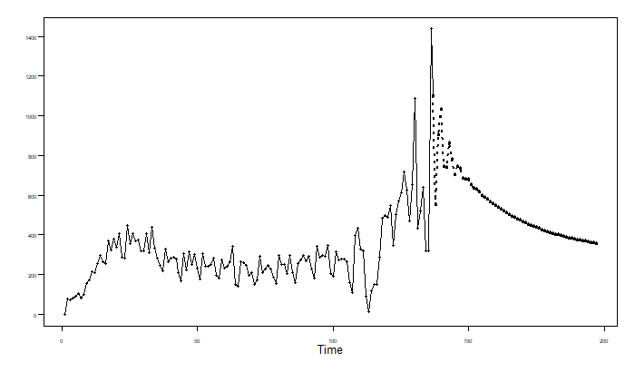
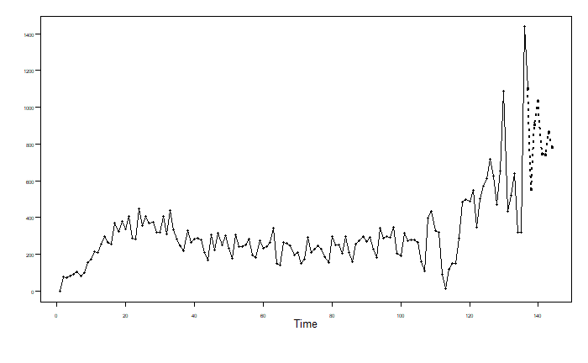
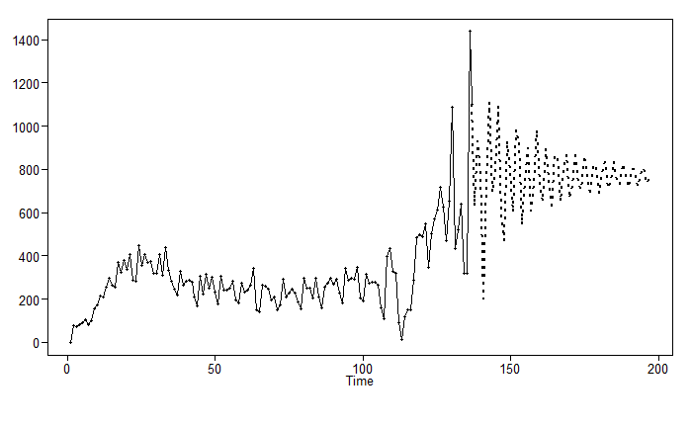
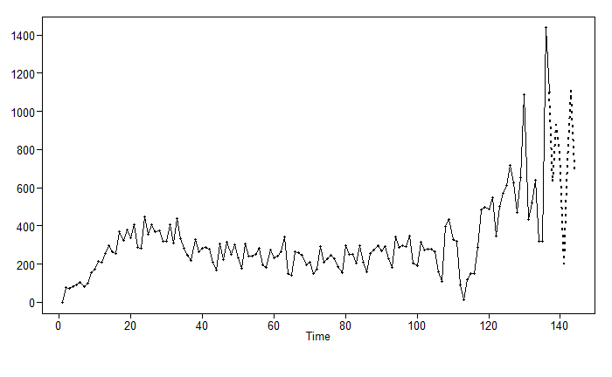
WA State – Forecasting Comparison
AR(3) model
Long term (next 60 days) Forecasts
Short term (next 7 days) Forecasts
ARIMA(6,1,0) model
Long term (next 60 days) Forecasts
Short term (next 7 days) Forecasts

Slide 11
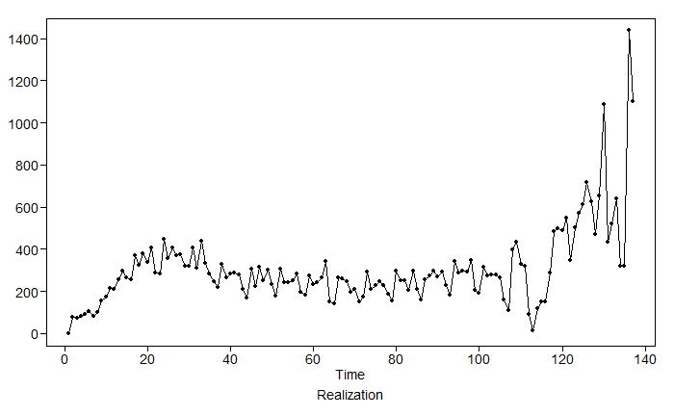
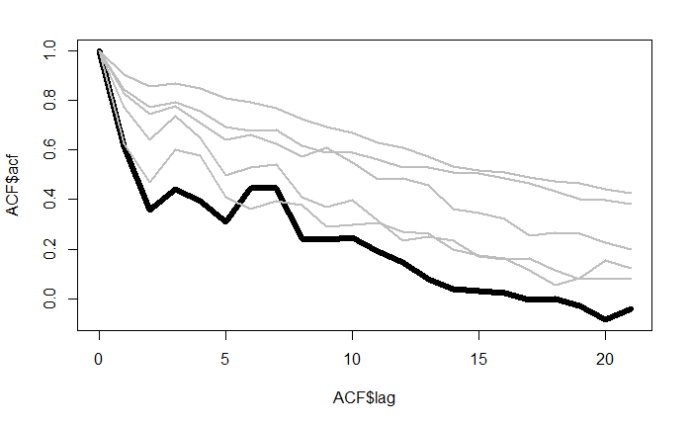
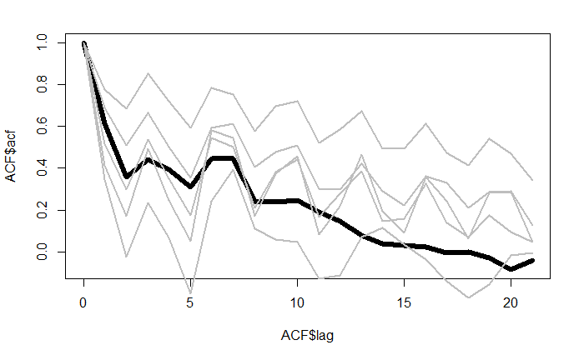
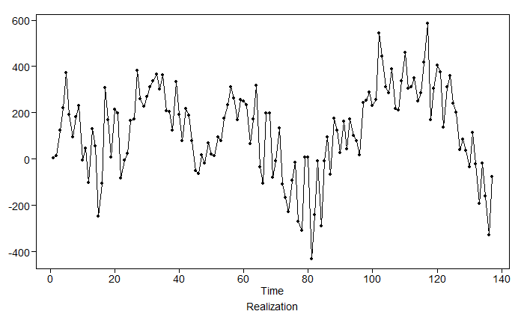
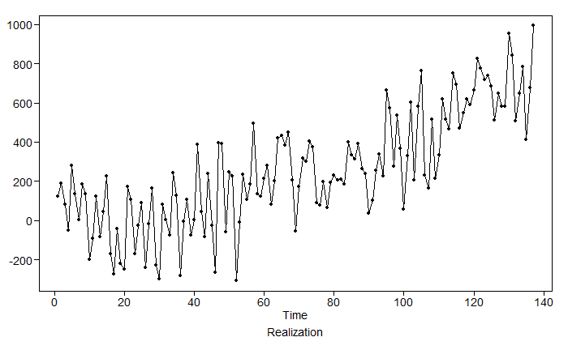
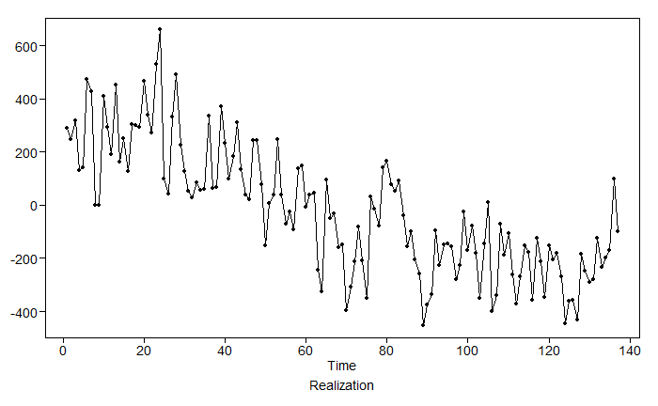
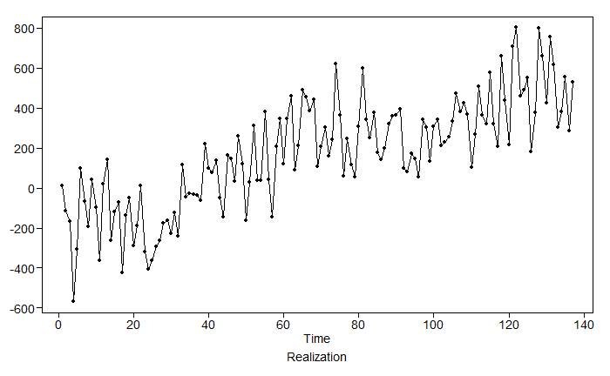
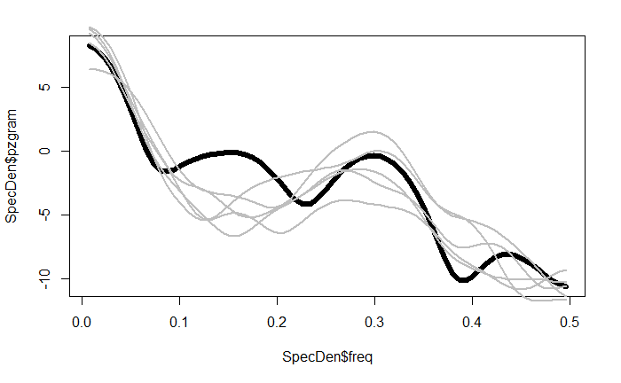
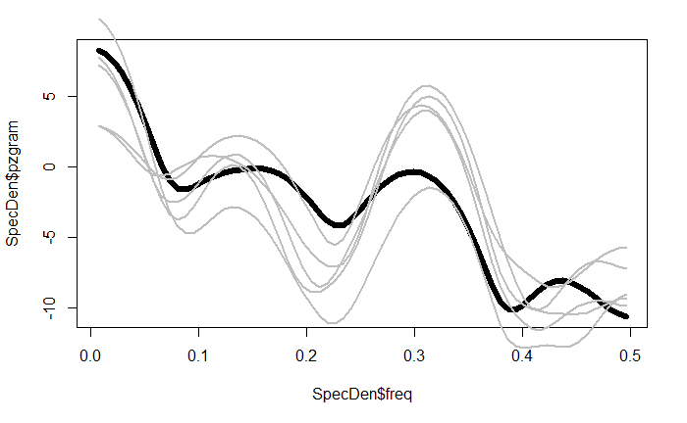
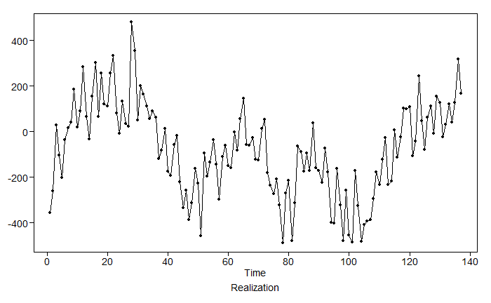
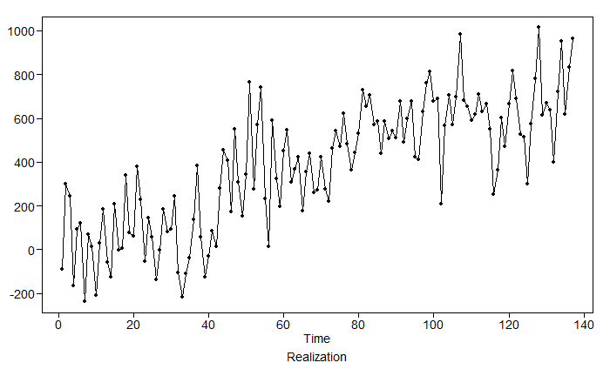
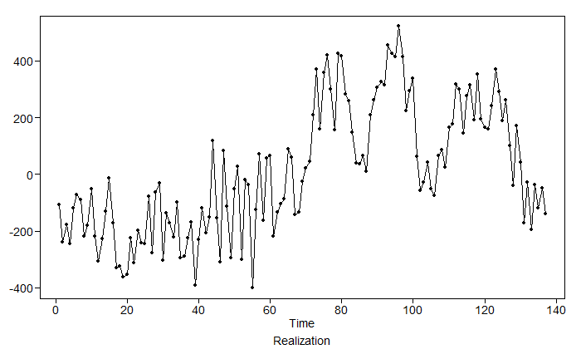
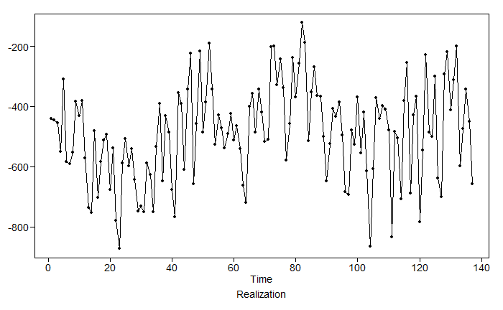
WA State: Realizations and Characteristics Comparison
ACF Comparison
ARIMA(6,1,0) Model
AR(3) Model
Realization Comparison
AR(3) Model
ARIMA(6,1,0) Model
Spectral Density Comparison
AR(3) Model
ARIMA(6,1,0) Model

Slide 12
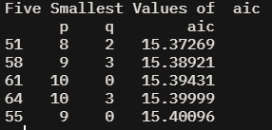
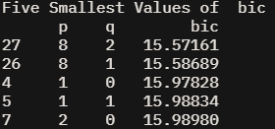
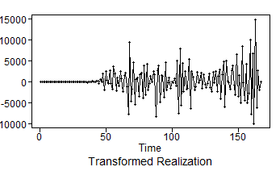
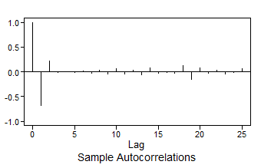
US - ARMA Model ID
AIC and BIC both indicate that an ARMA(8,2) might be an appropriate model.
Visual evidence from ACF plot that the residuals with ARMA(8,2) model are not white
Ljung-box test with K=48 (p-value 0.23) reject null hypothesis which suggests the residuals are not white

Slide 13
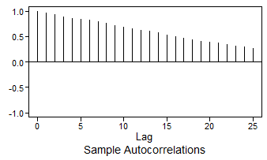
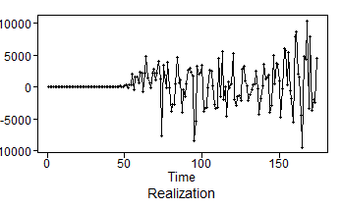
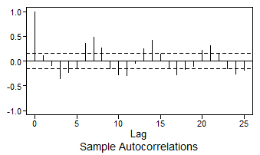
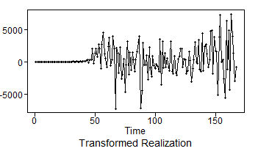
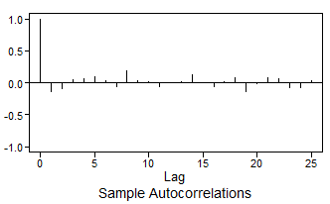
US - ARIMA Model ID
Auto correlations are slowly damping out which suggest a root on the unit circle. Dickey-fuller test (p-value :0.99) also suggest that there is root on the unit circle
We will proceed with including only a (1-B) term (i.e. d = 1).
The differenced data seems stationary, but the residual doesn’t seem to be white
AIC and BIC both confirm that an AR(7) model is appropriate for the differenced data.
Ljung-box test with K=24 and K=48 (p-value 0.22) fail to reject null hypothesis which suggests the residuals are white

Slide 14
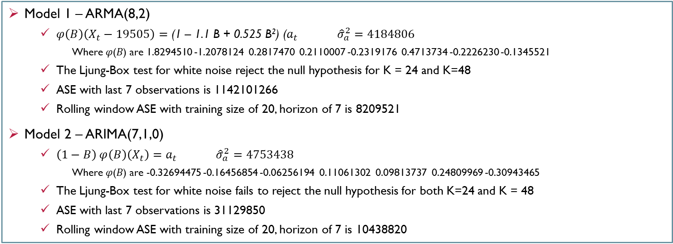
US – Model Comparison
Model 1 – ARMA(8,2)
$φ\left(B\right)\left(X_{t}−19505\right)={\text{(1 – }\text{1.1 }\text{B}\text{ + 0.52}\text{5 }\text{B}\text{2}\text{)} \text{(}a}_{t} {\hat{σ}}_{a}^{2}=4184806$
Where 𝜑(𝐵) are 1.8294510 -1.2078124 0.2817470 0.2110007 -0.2319176 0.4713734 -0.2226230 -0.1345521
The Ljung-Box test for white noise reject the null hypothesis for K = 24 and K=48
ASE with last 7 observations is 1142101266
Rolling window ASE with training size of 20, horizon of 7 is 8209521
Model 2 – ARIMA(7,1,0)
$\left(1−B\right) φ\left(B\right)\left(X_{t}\right)=a_{t} {\hat{σ}}_{a}^{2}=4753438$
Where 𝜑(𝐵) are -0.32694475 -0.16456854 -0.06256194 0.11061302 0.09813737 0.24809969 -0.30943465
The Ljung-Box test for white noise fails to reject the null hypothesis for both K=24 and K = 48
ASE with last 7 observations is 31129850
Rolling window ASE with training size of 20, horizon of 7 is 10438820

Slide 15
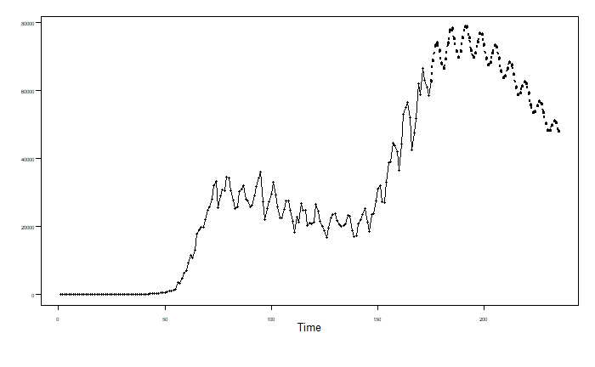
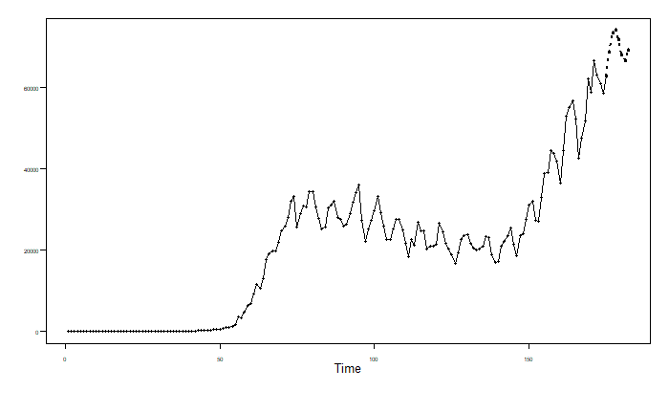
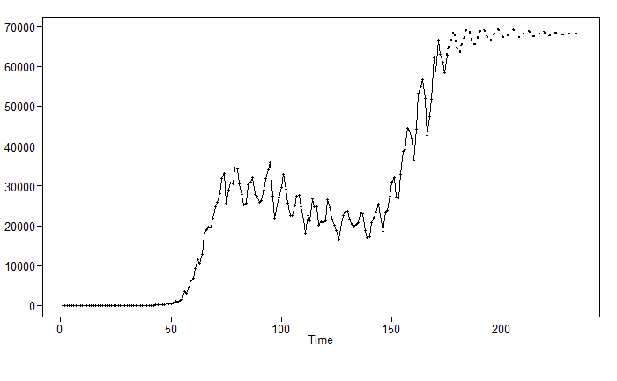
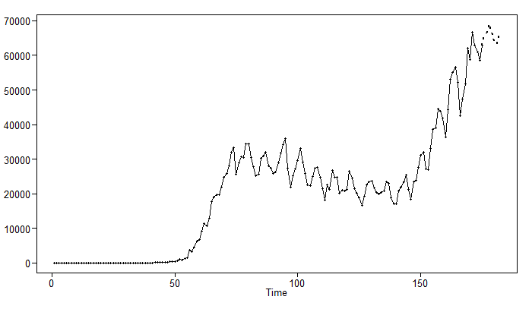
US – Forecasting Comparison
ARMA(8,2) model
Long term (next 60 days) Forecasts
Short term (next 7 days) Forecasts
ARIMA(7,1,0) model
Long term (next 60 days) Forecasts
Short term (next 7 days) Forecasts

Slide 16
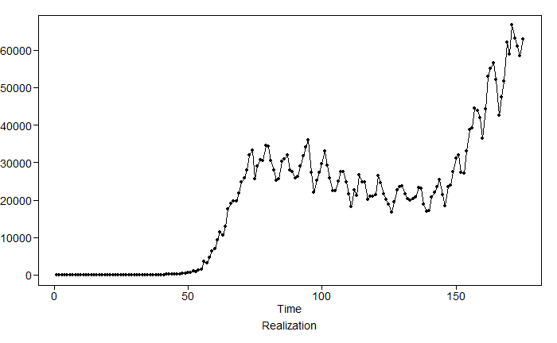
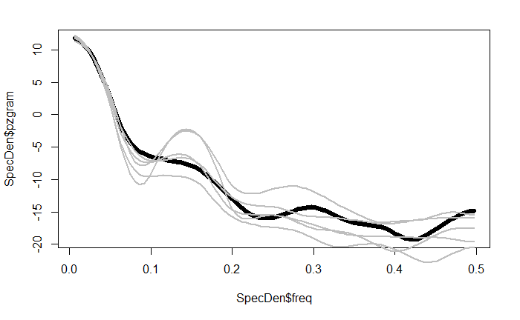
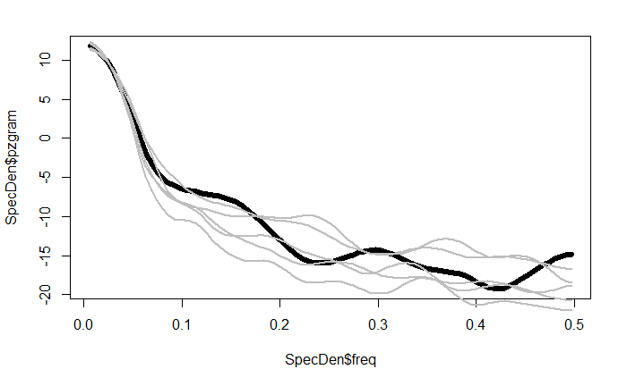
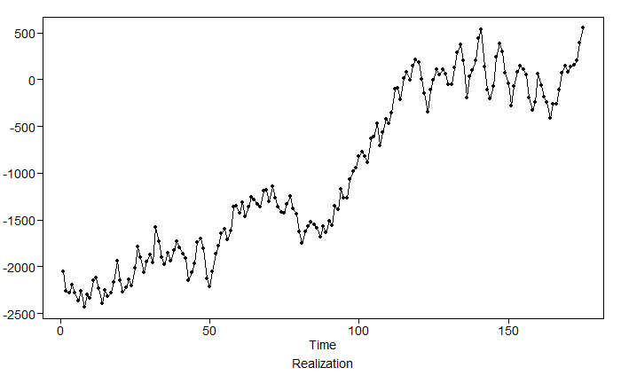
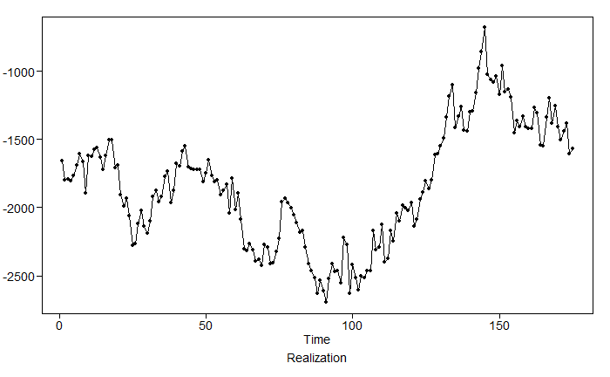
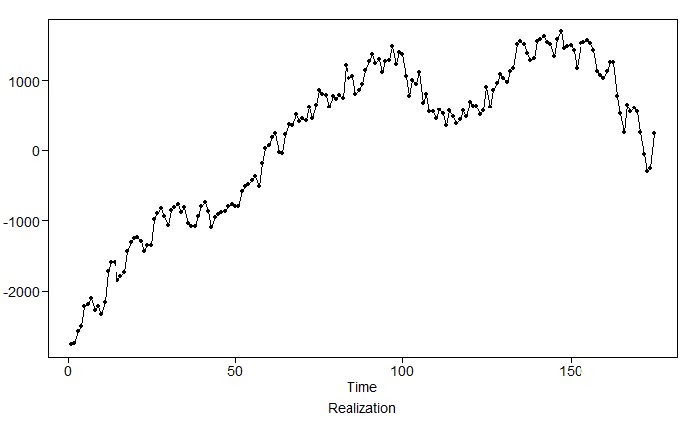







US: Realizations and Characteristics Comparison
ARMA(8,2) Model
ACF Comparison
ARIMA(7,1,0) Model
Realization Comparison
ARMA(8,2) Model
ARIMA(7,1,0) Model
ARMA(8,2) Model
Spectral Density Comparison
ARIMA(7,1,0) Model

Slide 17
Key Findings and Future Strategies
Generated residuals that are white noise both for WA state and US
Forecasts are better with ARIMA models for WA state and US
AR Model captures characteristics of the data better than ARIMA for WA state, but ARIMA has lowest mean ASE than AR
ARIMA Model captures characteristics of the data better than ARMA for US and , but ARMA has lowest mean ASE than ARIMA
Modeling the COVID using univariate analysis is not easy. Fit COVID data with MLP model and planning to add exogenous variables into this analysis to improve short term and longterm forecasts

